Slide 1

Welcome
GUI Programming
with Java
Session 10
Graphics and Java 2D

Slide 2

Objectives
We will look at…
  Basic Geometry
  Drawing in SWING

Slide 3
Outline
In this session we will look at
The graphics capabilities of Java
The color class
Drawing simple shapes
Drawing filled and 3D shapes
Drawing arcs
Drawing polygons and polylines

Slide 4
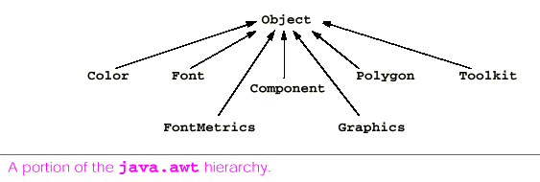
Introduction
The graphics capabilities of Java for drawing on the screen are shown in the diagram below.
This shows a portion of the java.awt class hierarchy.
Each class in the figure inherits directly from the class Object.

Slide 5
Introduction
Class Color contains methods and constants for manipulating colours.
Class Font contains methods and constants for manipulating fonts.
Class FontMetrics contains methods and constants for obtaining font information about the fonts on your system.
Class Polygon contains methods and constants for creating polygon shapes.
Class Graphics contains methods for drawing strings, lines, rectangles and other shapes.
Class Toolkit provides methods for getting graphical information from a system such as the set of displayable fonts and the display screen resolution.

Slide 6
Color Control
Color enhances the appearance of an application.
Class Color defines methods and constants for manipulating colors in a Java program.
Every color is created from a Red, Green and Blue component. Together these are called RGB values.
The larger the RGB value, the greater the amount of particular color.
Enables a programmer to choose between 256 X 256 X 256 colors (or 16.7 million colors).

Slide 7
Color Control
Number of useful methods within the class
public color (int r, int g, int b)
  Creates a color based on red, green and blue expressed as integers.
public color (float r, float g, float b)
  Creates a color based on red, green and blue expressed as floating point values between 0.0 and 1.0
int getRed()
  Returns a value between 0 and 255 representing the red content.

Slide 8
Color Control
public int getBlue()
  Returns a value between 0 and 255 representing the blue content.
public int getGreen()
  Returns a value between 0 and 255 representing the green content.
public Color getColor()
  Returns a color object representing the current color in the graphics context.
public void setColor( Color c )
  Sets a color object representing the current color in the graphics context.

Slide 9
Color Control
Lets take a look at an example of using the Color class in java.
  example1\ShowColors.java
One of the new features of Java is the predefined GUI component JColorChooser. Lets take a look at it in
  example2\ShowColors2.java

Slide 10
Drawing Shapes - Line
public void drawLine (int x1, int y1, int x2, int y2)
  Draws a line between the pint (x1,y1) and (x2,y2)
(x1,y1)
(x2,y2)

Slide 11
Drawing Shapes - Rectangle
public void drawRect (int x, int y, int width, int height)
  Draws a rectangle of specified width and height. The top left corner of the rectangle has the coordinates (x,y)
(x,y)
height
width

Slide 12
Drawing Shapes - Rectangle
There are several other types of rectangle we can draw
public void fillRect (int x, int y, int width, int height)
  Draws a solid rectangle of specified width and height. The top left corner of the rectangle has the coordinates (x,y)
public void clearRect (int x, int y, int width, int height)
  Draws a clear rectangle of specified width and height. The top left corner of the rectangle has the coordinates (x,y)
public void drawRoundRect (int x, int y, int width, int height, int arcWidth, int arcHeight)
  Draws a rectangle of specified width and height. The top left corner of the rectangle has the coordinates (x,y). The values of arcWidth and arcHeight determine the rounding of the corners.

Slide 13
Drawing Shapes - Rectangle
public void fillRoundRect (int x, int y, int width, int height, int arcWidth, int arcHeight)
  Draws a solid rectangle of specified width and height. The top left corner of the rectangle has the coordinates (x,y). The values of arcWidth and arcHeight determine the rounding of the corners.
public void draw3DRect (int x, int y, int width, int height, boolean b)
  Draws a 3 dimensional rectangle of specified width and height. The top left corner of the rectangle has the coordinates (x,y). The rectangle appears raised when b is true and lowered when b is false.

Slide 14
Drawing Shapes - Rectangle
public void fill3DRect (int x, int y, int width, int height, boolean b)
  Draws a solid 3 dimensional rectangle of specified width and height. The top left corner of the rectangle has the coordinates (x,y). The rectangle appears raised when b is true and lowered when b is false.

Slide 15
Drawing Shapes - Ovals
public void drawOval (int x, int y, int width, int height)
  Draws an oval in the current color of specified width and height. The bounding rectangles top left corner of the oval has the coordinates (x,y)
(x,y)
height
width

Slide 16
Drawing Shapes - Ovals
public void fillOval (int x, int y, int width, int height)
  Draws a filled oval in the current color of specified width and height. The bounding rectangles top left corner of the oval has the coordinates (x,y)
(x,y)
E124
height
width

Slide 17
Drawing Shapes
Lets take a look at an example of drawing shapes in java.
  example3\LinesRectsOvals.java

Slide 18
Drawing Arcs
An arc is a portion of a circle.
Arc angles are measured in degrees.
An arc is drawn between two angles: a starting angles and an arc angle
The starting angle is the degree where the arc begins
The arc angle is the last degree of the arc.
Arcs sweep between their starting angle and their arc angle.
Arcs that sweep in a:
counter-clockwise direction are measured in positive degrees.
clockwise direction are measured in negative degrees.

Slide 19
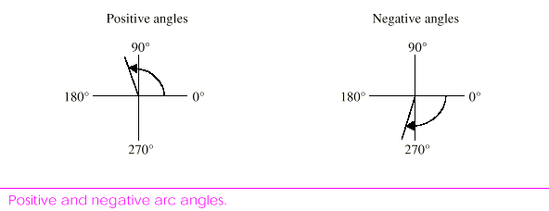
Drawing Arcs
Arcs that sweep in a:
  counter-clockwise direction are measured in positive degrees.
  clockwise direction are measured in negative degrees.

Slide 20
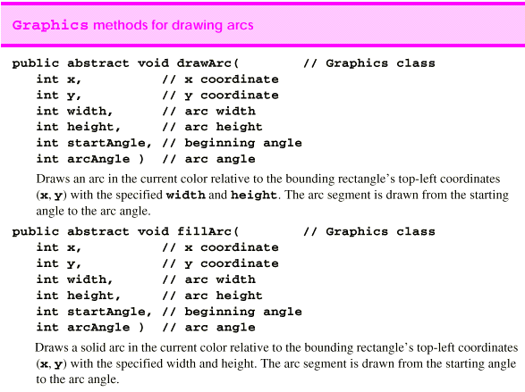

Slide 21
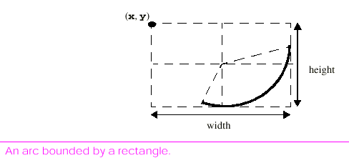
Drawing Arcs
Take a look at example 4/ LinesRectsOvals.java

Slide 22
Drawing Polygons and PolyLines
Polygons are multisided shapes.
Ploylines are a series of connected points.
Lets take a look at some of the methods we can use to create these in java.
When you are familiar with these take a look at example5\DrawPolygons.java

Slide 23
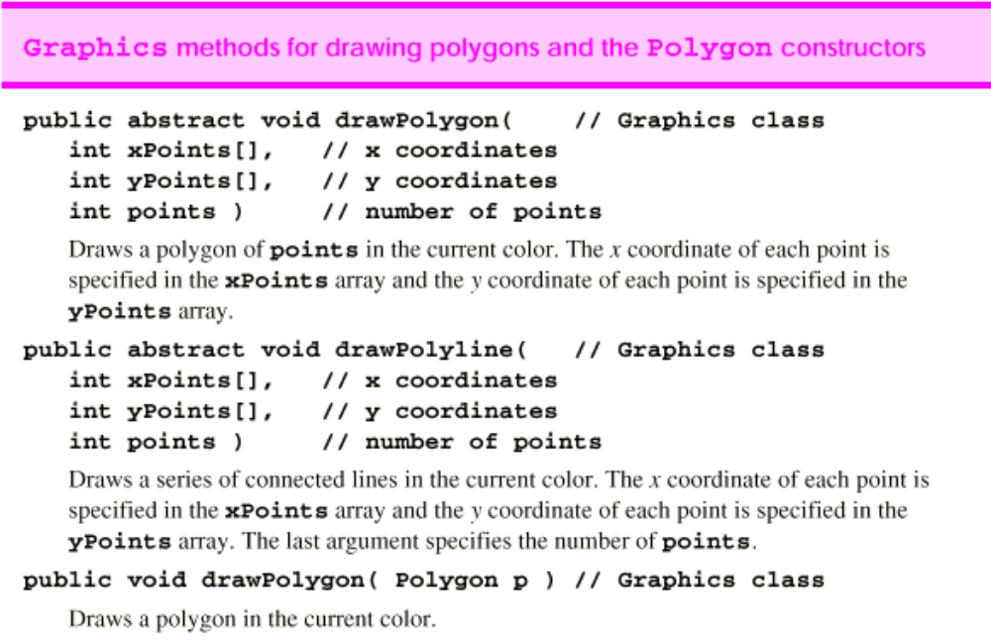

Slide 24
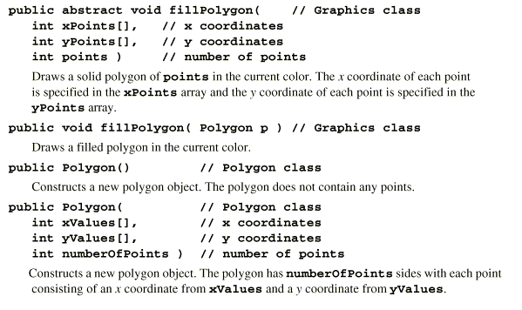
& …..

Slide 25
Summary
In this session we have looked at
The graphics capabilities of Java
The color class
Drawing simple shapes
Drawing filled and 3D shapes
Drawing arcs
Drawing polygons and polylines

Slide 26
Labwork 10:
Create your own sample JFrame and draw three sample graphics from the available graphic commands shown in the lecture, e.g., drawRect, drawLine, drawPolygon etc.

